Slide 1

Rossman Pharmaceutical sales prediction across multiple stores
NextHikes
Submitted by: Madhuri siddhapura

Slide 2
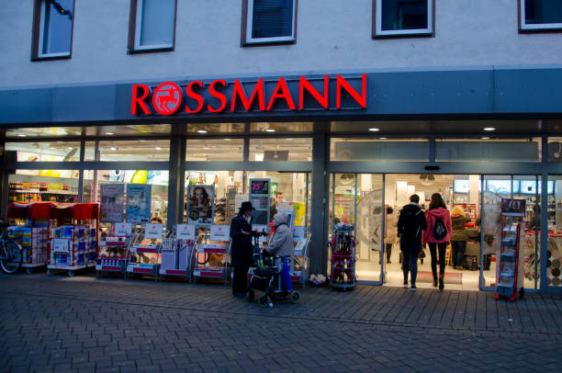
Introduction
Predicting sales performance is one of the key challenges every business face.
It is important for firms to predict customer demands to offer the right product at the right time and at the right place.
The importance of this issue is underlined by the fact that figuratively a bazillion consulting firms are on the market trying to offer sales forecasting services to businesses of all sizes.

Slide 3
Project Need
Rossmann operates over 3,000 drug stores in 7 European countries.
Currently, Rossmann store managers are tasked with predicting their daily sales for up to six weeks in advance.
Store sales are influenced by many factors, including promotions, competition, school and state holidays, seasonality, and locality.
With thousands of individual managers predicting sales based on their unique circumstances, the accuracy of results can be quite varied.

Slide 4
Datasets and features
Id - an Id that represents a (Store, Date) duple within the test set
Store - a unique Id for each store
Sales - the turnover for any given day (this is what you are predicting)
Customers - the number of customers on a given day
Open - an indicator for whether the store was open: 0 = closed, 1 = open
StateHoliday - indicates a state holiday. Normally all stores, with few exceptions, are closed on state holidays. Note that all schools are closed on public holidays and weekends. a = public holiday, b = Easter holiday, c = Christmas, 0 = None
SchoolHoliday - indicates if the (Store, Date) was affected by the closure of public schools
StoreType - differentiates between 4 different store models: a, b, c, d
Assortment - describes an assortment level: a = basic, b = extra, c = extended.

Slide 5
Datasets and features
CompetitionDistance - distance in meters to the nearest competitor store
CompetitionOpenSince[Month/Year] - gives the approximate year and month of the time the nearest competitor was opened
Promo - indicates whether a store is running a promo on that day
Promo2 - Promo2 is a continuing and consecutive promotion for some stores: 0 = store is not participating, 1 = store is participating
Promo2Since[Year/Week] - describes the year and calendar week when the store started participating in Promo2
PromoInterval - describes the consecutive intervals Promo2 is started, naming the months the promotion is started anew. E.g. "Feb,May,Aug,Nov" means each round starts in February, May, August, November of any given year for that store

Slide 6
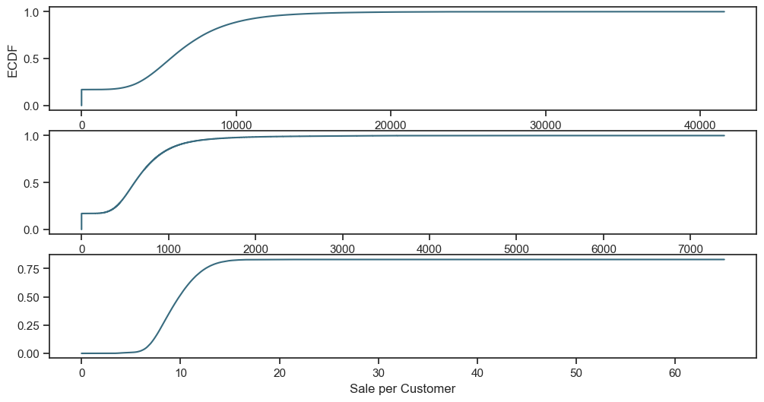
Exploration of customer purchasing behaviour
Distibution of two emprical variables: Sales and Customers are checked
About 20% of data has zero amount of sales / customers that we need to deal with and
almost 80% of time daily amount of sales was less than 1000.

Slide 7
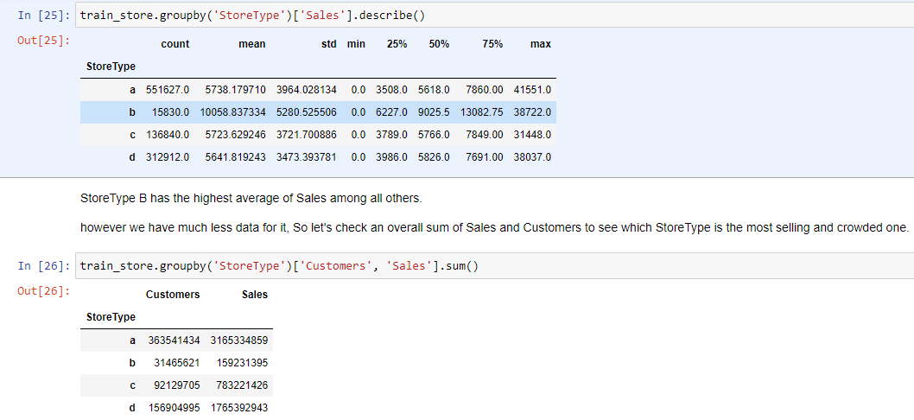
Checking the distribution of sales among Store types

Slide 8
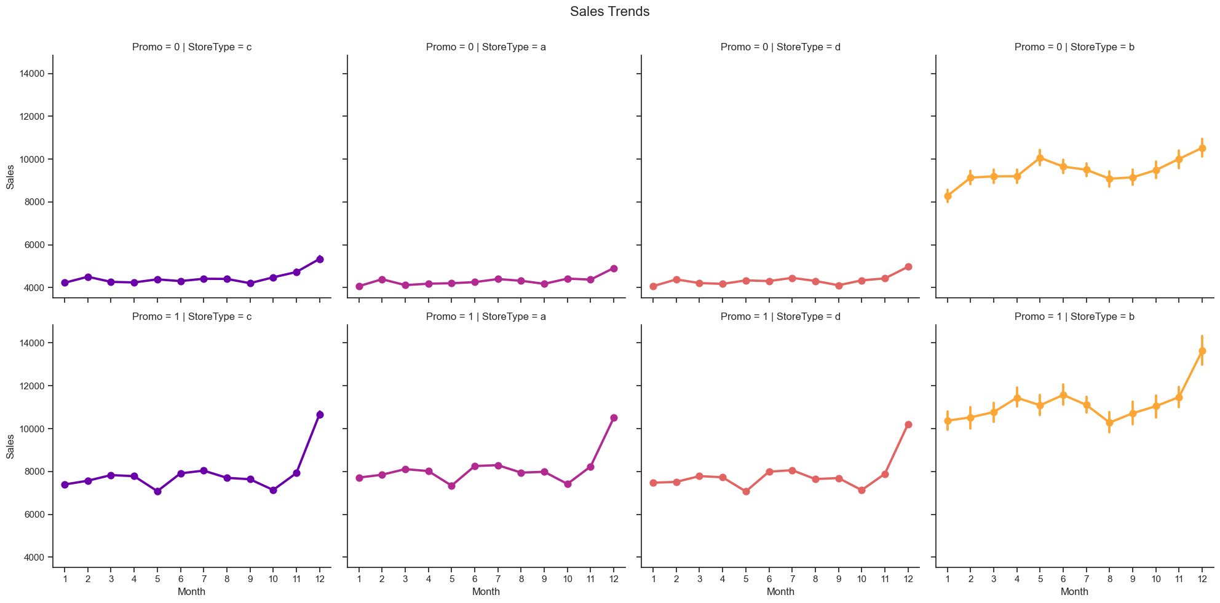
Sales Trends

Slide 9
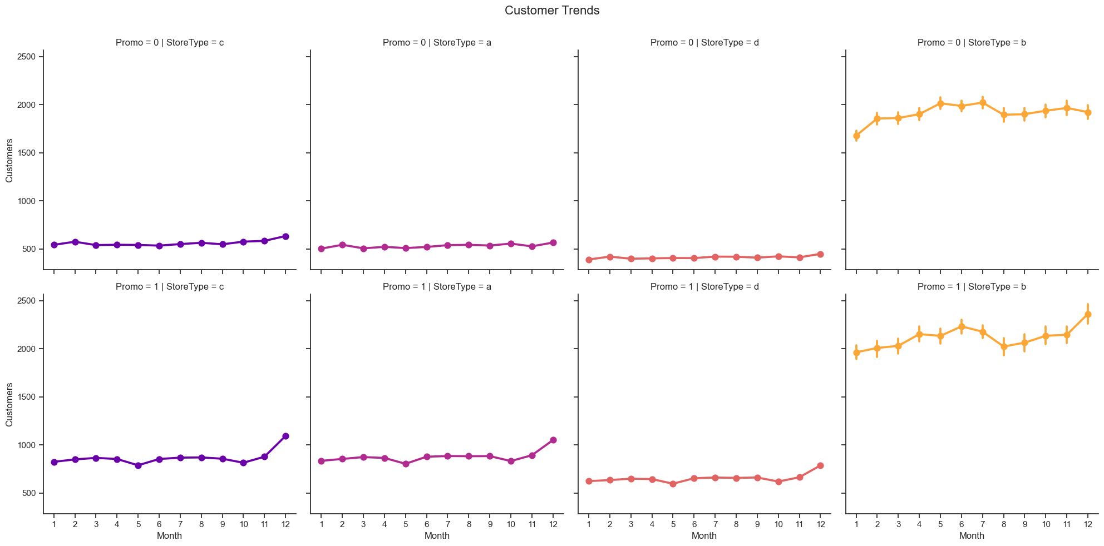
Customer Trends
All store types follow the same trend but at different scales depending on the presence of the (first) promotion Promo and StoreType itself (case for B).

Slide 10
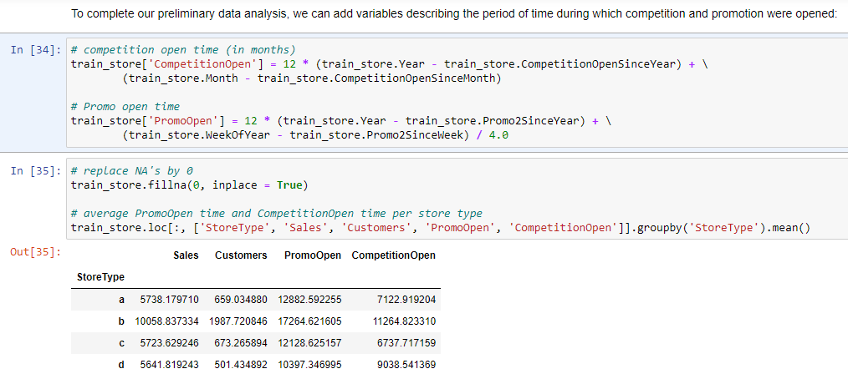
The most selling and crowded StoreType A doesn't appear to be the one the most exposed to competitors. Instead it's a StoreType B, which also has the longest running period of promotion.

Slide 11
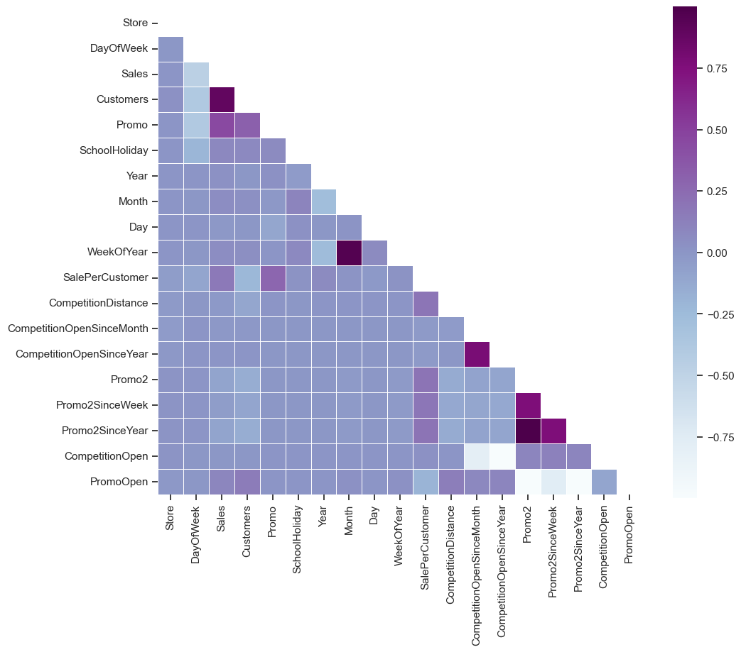
Correlational Analysis
As mentioned before, we have a strong positive correlation between the amount of Sales and Customers of a store. We can also observe a positive correlation between the fact that the store had a running promotion (Promo equal to 1) and amount of Customers.
However, as soon as the store continues a consecutive promotion (Promo2 equal to 1) the number of Customers and Sales seems to stay the same or even decrease, which is described by the pale negative correlation on the heatmap. The same negative correlation is observed between the presence of the promotion in the store and the day of a week.

Slide 12
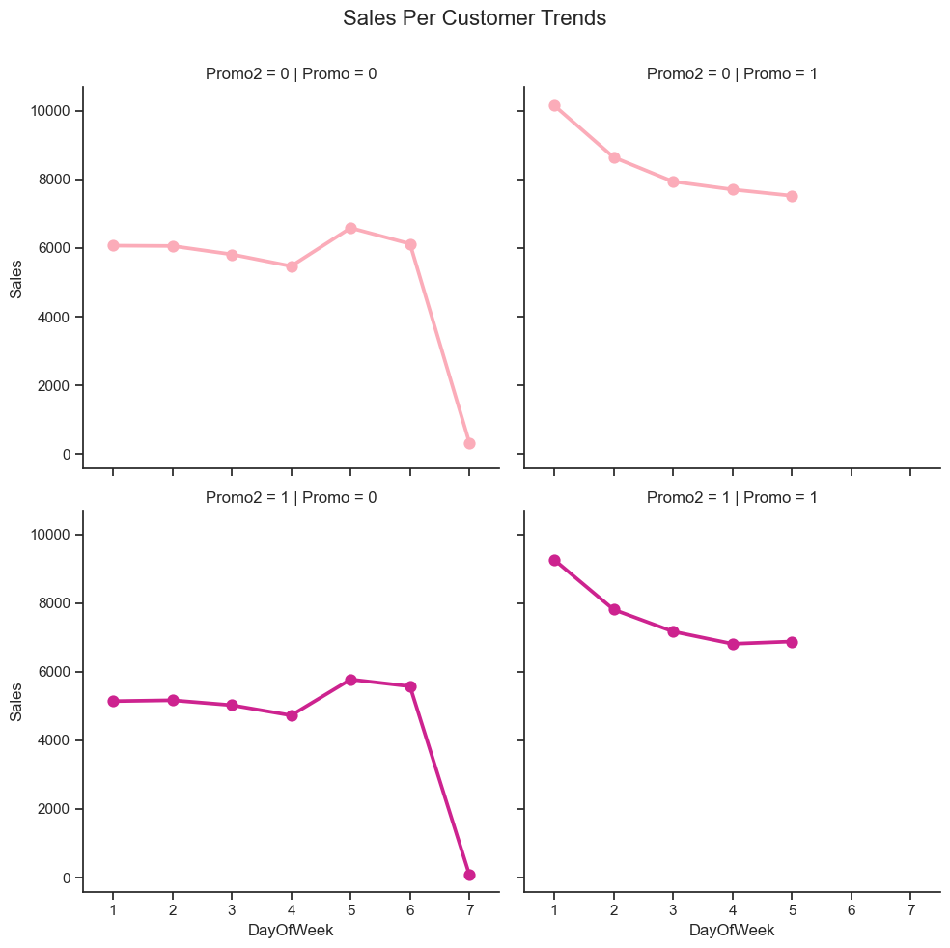
There are several things here:
In case of no promotion, both Promo and Promo2 are equal to 0, Sales tend to peak on Sunday (!). Though we should note that StoreType C doesn't work on Sundays. So it is mainly data from StoreType A, B and D.
On the contrary, stores that run the promotion tend to make most of the Sales on Monday. This fact could be a good indicator for Rossmann marketing campaigns. The same trend follow the stores which have both promotion at the same time (Promo and Promo2 are equal to 1).
Promo2 alone doesn't seem to be correlated to any significant change in the Sales amount. This can be also prooved by the blue pale area on the heatmap above.

Slide 13
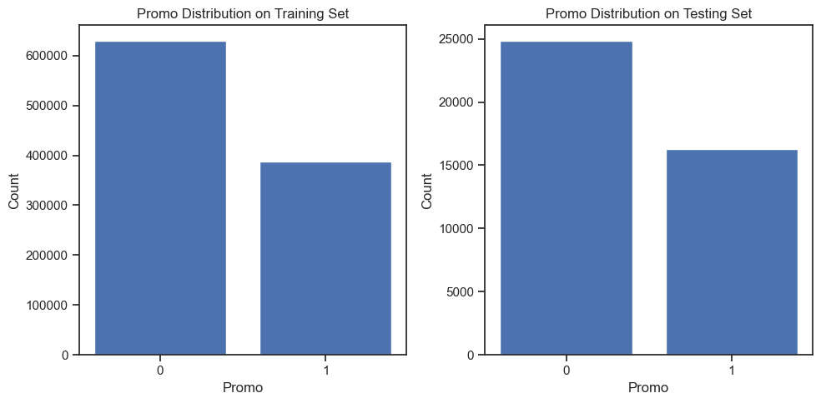
Check for distribution in both training and test sets - are the promotions distributed similarly between these two groups?
Observation: The distributiuon of promo over ontraining stet is greater than the promo distribution over test set

Slide 14
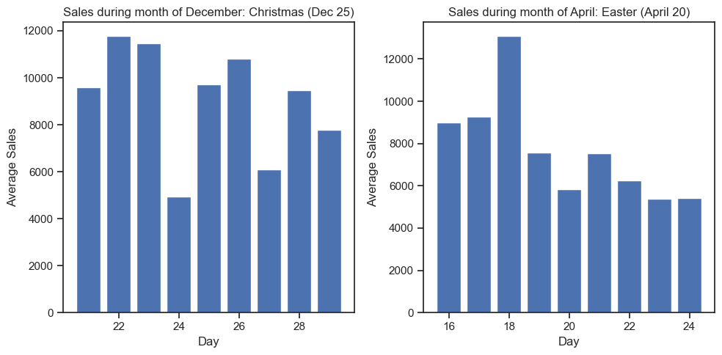
Check & compare sales behavior before, during and after holidays
Observation: There are more sales before and after the Holidays when it compared to holidays sales

Slide 15
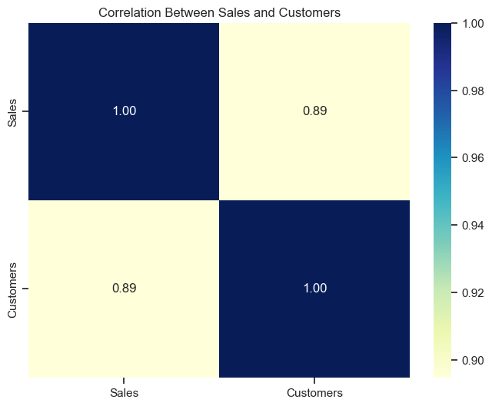
Observation: The more customers the more sales. because there is a high correlation between Sales and Customers

Slide 16
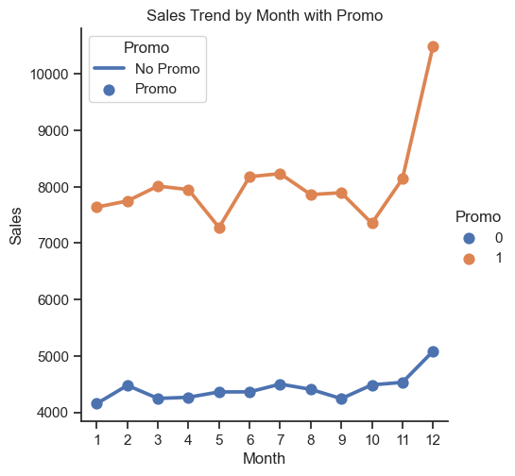
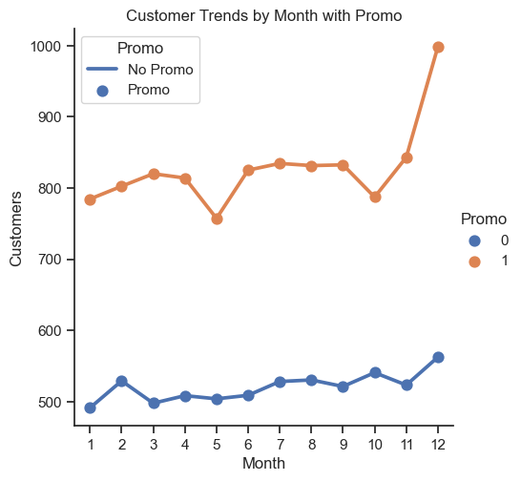
How does promo affect sales? Are the promos attracting more customers? How does it affect already existing customers?
Observation: Working on promotion increase the customers base and Increase Sales.

Slide 17
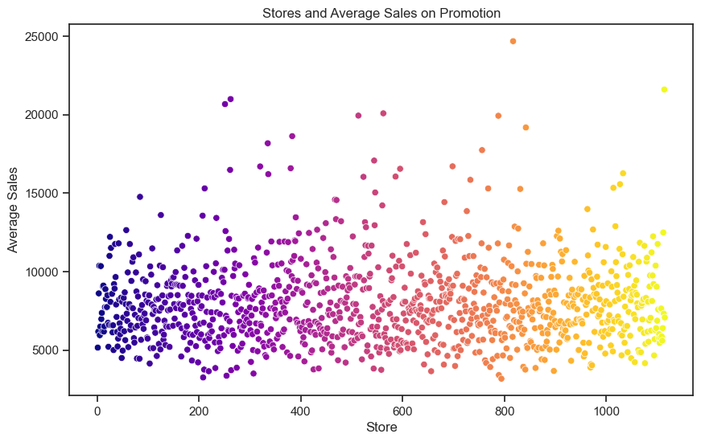
Could the promos be deployed in more effective ways? Which stores should promos be deployed in?

Slide 18
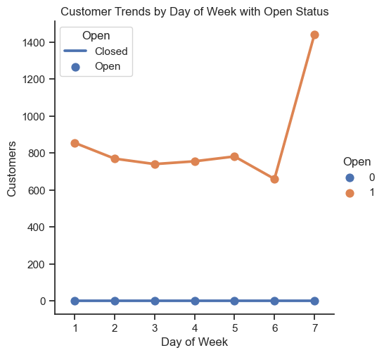
Trends of customer behavior during store open and closing times
Observation: Number of customers increase when the store is closed.

Slide 19
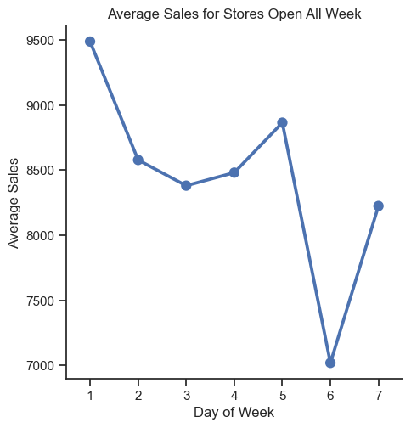
Which stores are opened on all weekdays? How does that affect their sales on weekends?
Observation: About 33 stores are opened on all weekdays and the sales escalate on weekends.

Slide 20
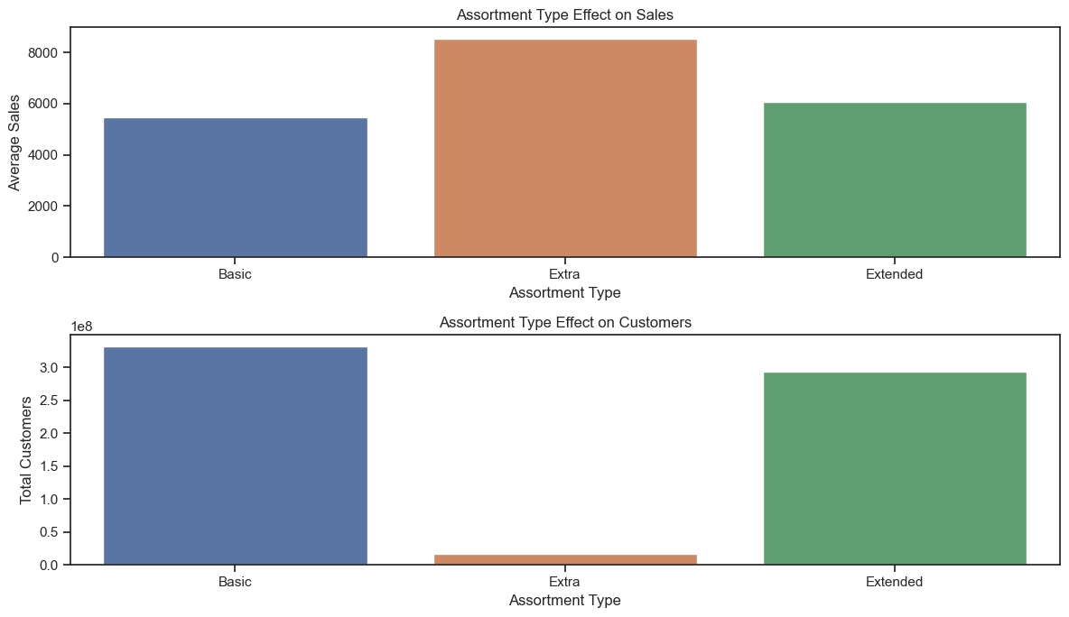
Check how the assortment type affects sales

Slide 21

Check how the assortment type affects sales
Observation: The stores with extra assortment type have high mean sales and lowest customer numbers.

Slide 22
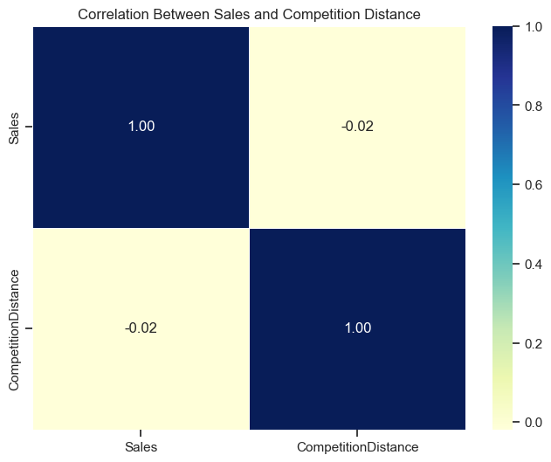
How does the distance to the next competitor affect sales? What if the store and its competitors all happen to be in city centers, does the distance matter in that case?
Observation: The more the closer the stores the higher the sales, and the more the distant the lower the sales.

Slide 23
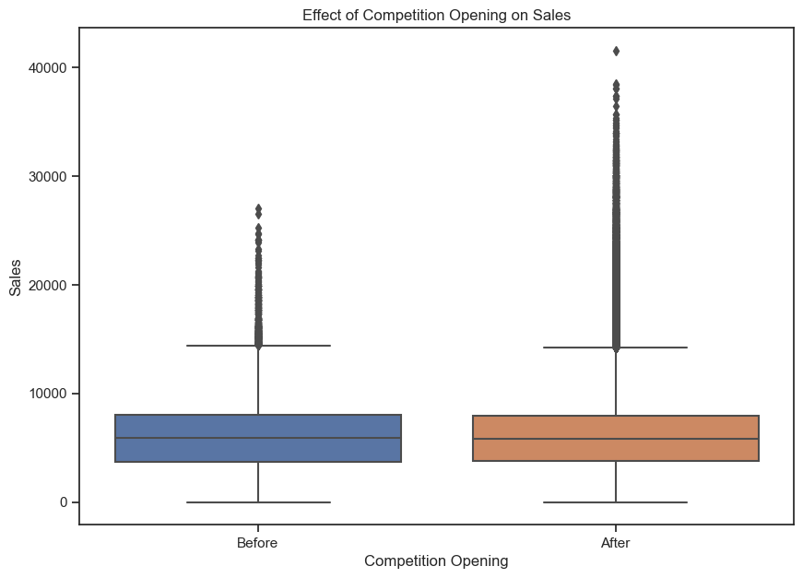
How does the opening or reopening of new competitors affect stores? Check for stores with NA as competitor distance but later on has values for competitor distance?
Observations: Number of sales increase when the competitors are opened.

Slide 24
Conclusion of EDA
The most selling and crowded StoreType is A.
The best "Sale per Customer" StoreType D indicates to the higher Buyer Cart. To benefit from this fact, Rossmann can consider proposing bigger variety of its products.
Low SalePerCustomer amount for StoreType B indicates to the possible fact that people shop there essentially for "small" things. Even though this StoreType generated the least amount of sales and customers over the whole period, it shows a great potential.
Customers tends to buy more on Mondays when there's one promotion (Promo) and on Sundays when there's no promotion at all (both Promo and Promo1 are equal to 0).
Promo2 alone doesn't seem to be correlated to any significant change in the Sales amount.

Slide 25
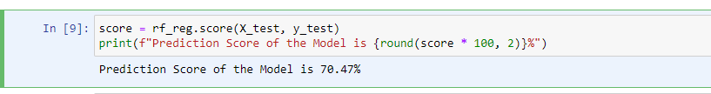
Prediction of store sales
For PreProcessing here using LabelEncoder, MinMaxScaler, and RandomForestRegressor model.
Prediction score of the model is 70.47%

Slide 26
Building models with sklearn pipelines
Prediction Score of the RandomForestRegretion is 63.47%
Prediction Score of the LinearRegretion is 57.65%
Prediction Score of the DecisionTree is 50.02%
Choose a loss function
RandomForest Root Mean Square Error: 2058.9773134579336
Linear Root Mean Square Error: 2217.142471012501
DecisionTree Root Mean Square Error: 2408.6399513003184

Slide 27
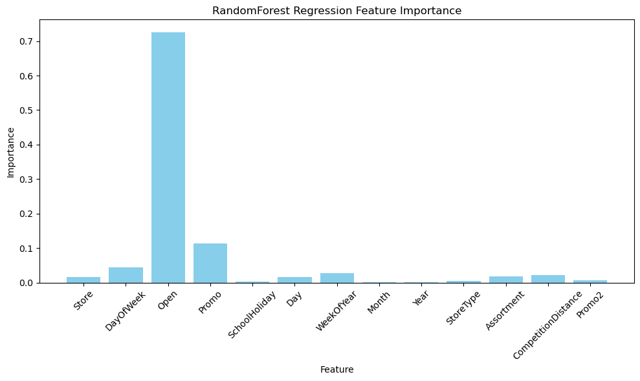
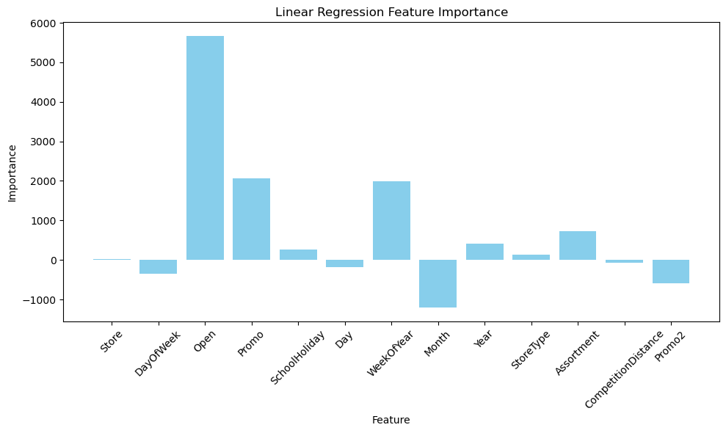
Post Prediction Analysis : Feature Importance

Slide 28
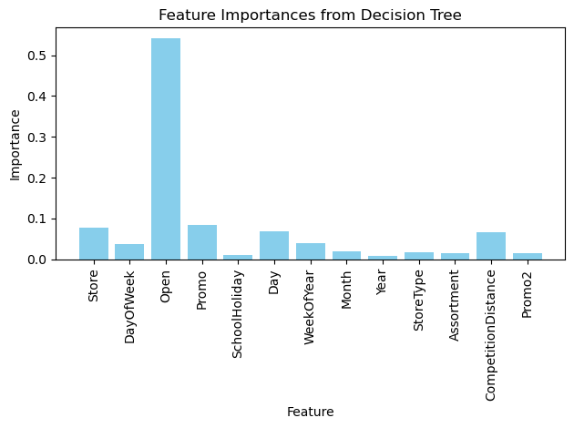

Slide 29



Serialize models
Read and save model -- serialization using pickle to dump mode
Regression Score:
Decision Tree Score:
Linear Regression Score:

Slide 30
Time Series Analysis
Time-Series Analysis per Store Type
We build a time series analysis on store types instead of individual stores. The main advantage of this approach is its simplicity of presentation and overall account for different trends and seasonalities in the dataset.
Seasonality and Yearly Trend
We take four stores from store types to represent their group:
Store number 2 for StoreType A
Store number 85 for StoreType B
Store number 1 for StoreType C
Store number 13 for StoreType D.
We take four stores from store types to represent their group: Store number 2 for StoreType A Store number 85 for StoreType B, Store number 1 for StoreType C Store number 13 for StoreType D. It also makes sense to down sample the data from days to weeks using the resample method to see the present trends more clearly.

Slide 31
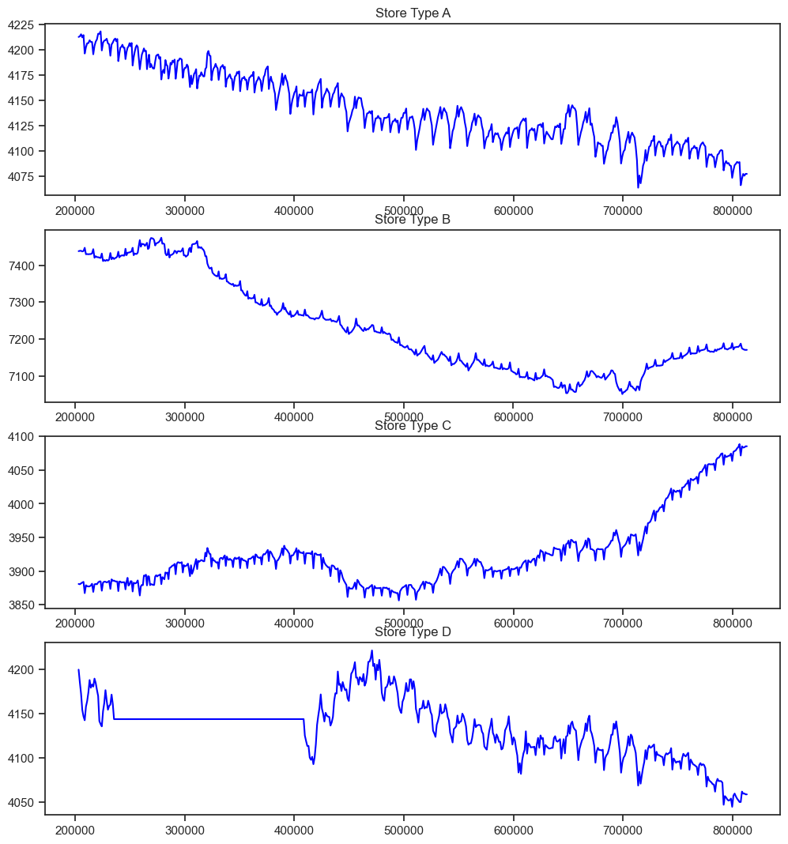
Observation: Overall sales seems to increase, however not for the StoreType C (a third from the top). Eventhough the StoreType A is the most selling store type in the dataset, it seems that it can follow the same decresing trajectory as StoreType C did.

Slide 32
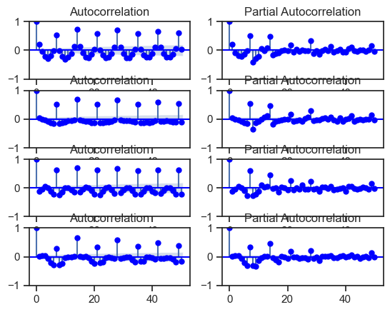
Autocorrelation
A
B
C
D
We can read these plots horizontally. Each horizontal pair is for one 'StoreType', from A to D. In general, those plots are showing the correlation of the series with itself, lagged by x time units correlation of the series with itself, lagged by x time units.

Slide 33
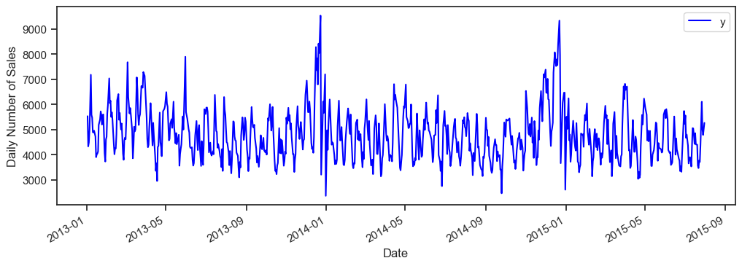
Forecasting with Prophet

Slide 34
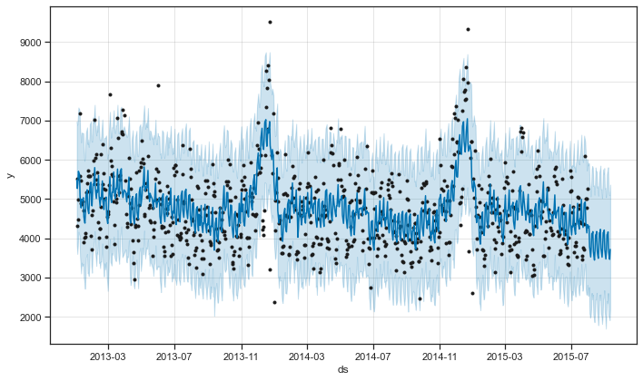
Modeling Holidays: Prophet also allows to model for holidays, and that's what we do here.
The StateHoliday variable in the dataset indicates a state holiday, at which all stores are normally closed. There are also school holidays in the dataset at which certain stores are also closing their doors.
Observation: Prophet plots the observed values of our time series (the black dots), the forecasted values (blue line) and the uncertainty intervals of our forecasts (the blue shaded regions).

Slide 35
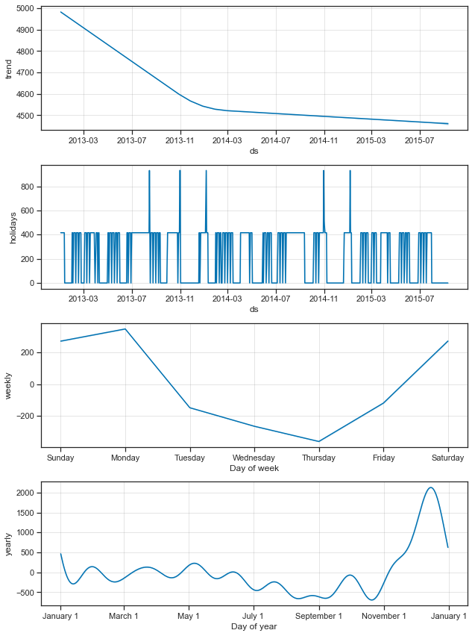
One other particularly strong feature of Prophet is its ability to return the components of our forecasts. This can help reveal how daily, weekly and yearly patterns of the time series plus manually included holidays contribute to the overall forecasted values:
Observation:
The first plot shows that the monthly sales of store number 1 has been linearly decreasing over time.
The second shows the holidays gaps included in the model.
The third plot highlights the fact that the weekly volume of last week sales peaks towards the Monday of the next week.
while the forth plot shows that the most buzy season occurs during the Christmas holidays.

Slide 36
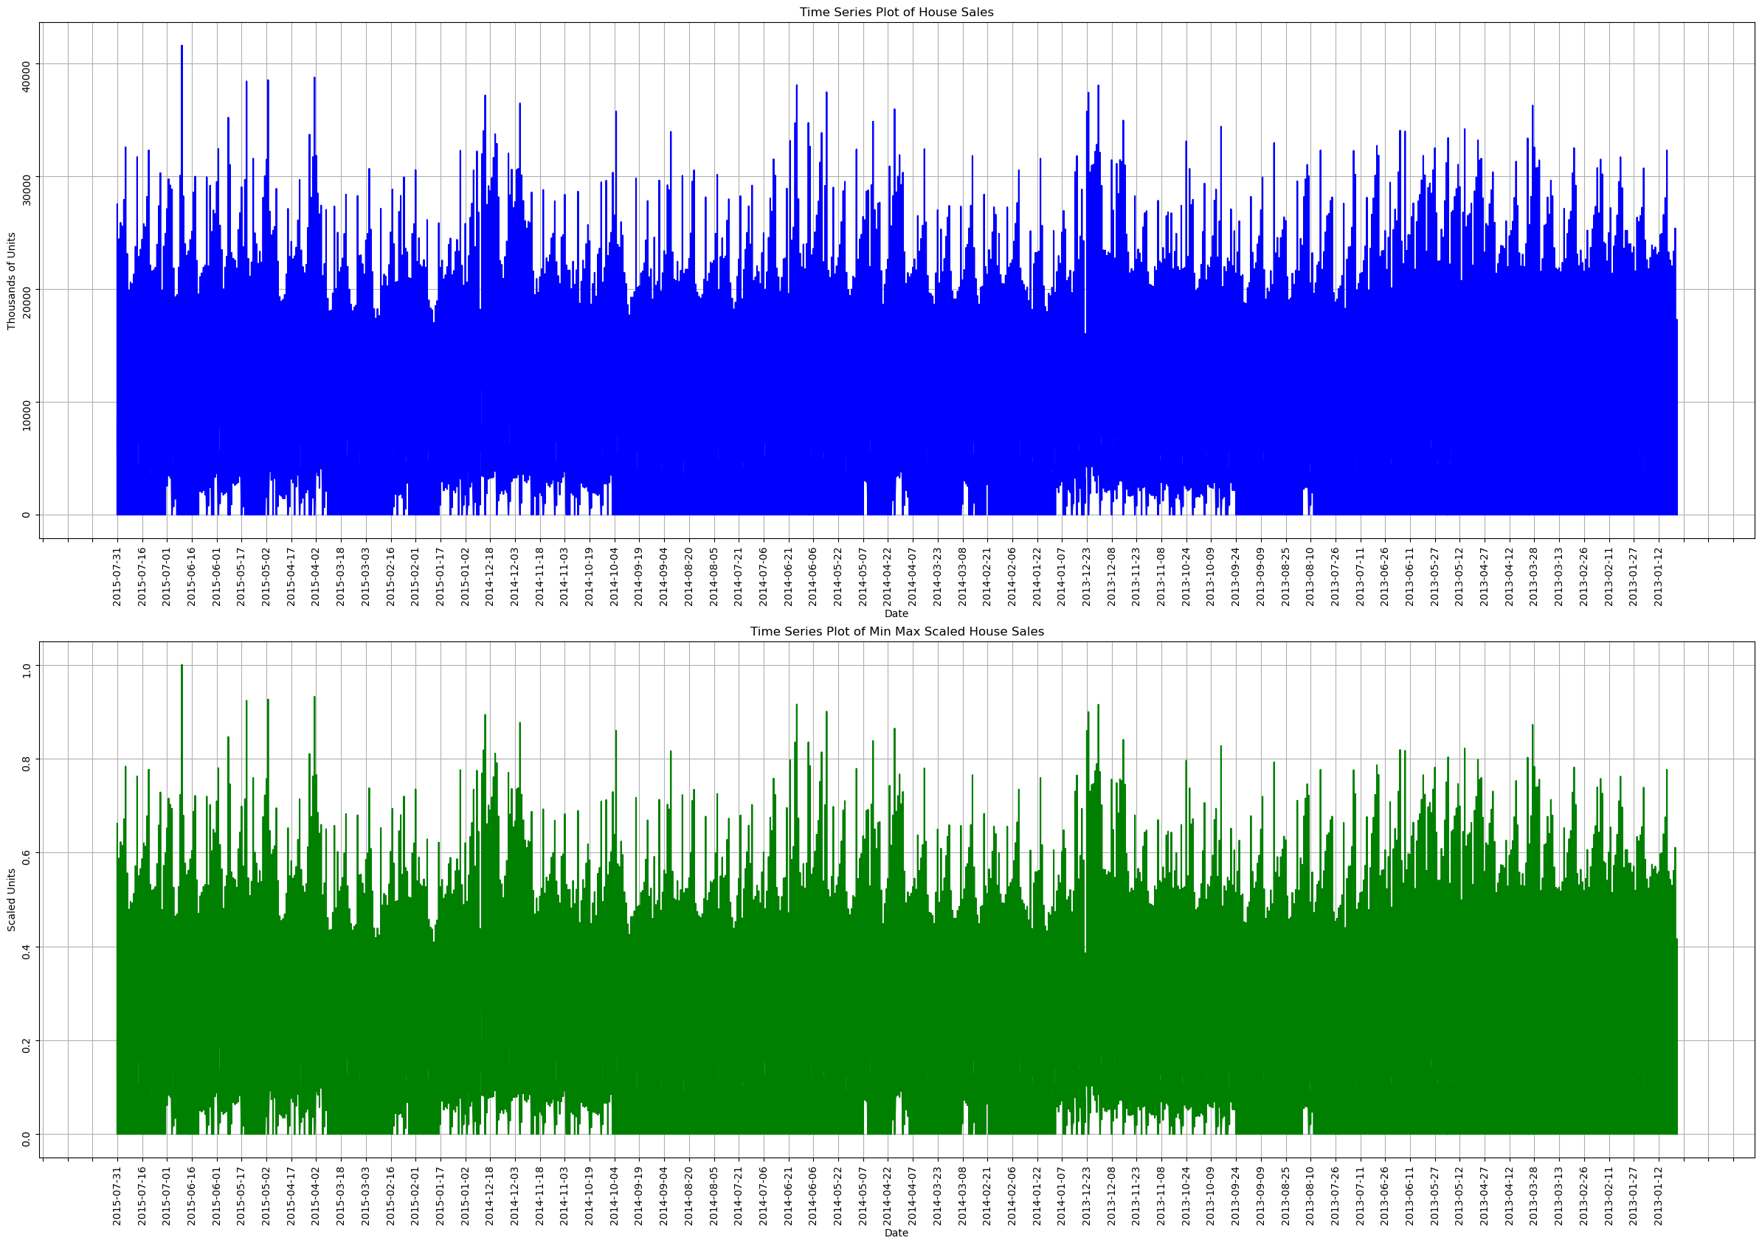
Isolate the Rossmann Store Sales dataset into time series data

Slide 37
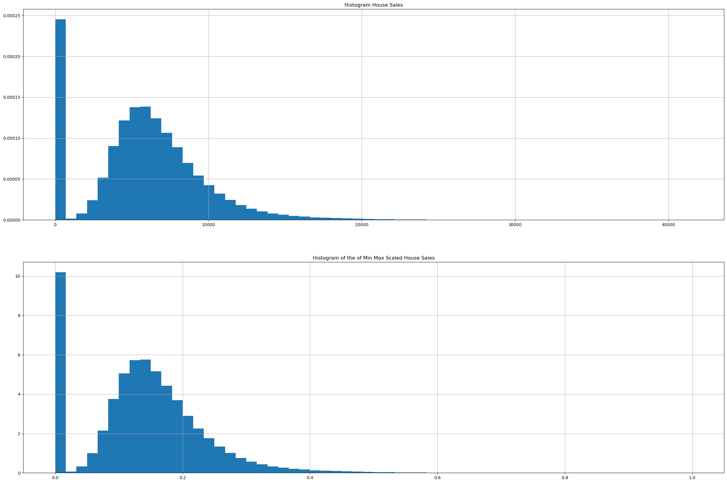

Slide 38
Deep Learning
Check whether your time Series Data is Stationary or non-stationary
KPSS Statistic: 0.7011624739400044
p-value: 0.013439775096363234
Number of lags used: 553
Critical Values: 10%: 0.347
5%: 0.463
2.5%: 0.574
1%: 0.739
KPSS test result: Non-stationary (reject null hypothesis)

Slide 39
Thank you
Guided By : Desmond Onam Sir
Shweta Sutar Mam

